Slide 1
Insulin Tracking Study

Slide 2
The Research:
A diabetic, especially type 1, requires insulin shots on a regular basis.
The dosage for a type 1 diabetic for daily insulin dosages is estimated at 0.4 to 1.0 units per kilogram of their body weight. This means a 120-lb person (~54 kg) would take between 21 units of insulin and 54 units in a day.
My own weight at 240-lbs (108 kg) would mean I would need between 43 units 108 and per day.
Medical professionals often refer to what’s known as the maximum daily dosage, so we’ll do the same and use the upper limit of 108 units a day.

Slide 3
The Question:
Is my insulin usage over the course of two weeks within the expected maximum bound? (108)

Slide 4
Variables:
Exercise can affect the amount of absorption. More exercise means less insulin is needed to achieve the desired blood sugar level (Mine is around 120, but this varies from person to person.)
Sickness can also impact the amount of insulin I used. There are two larger days of insulin that reflect this variable!
Working. I will be up and walking around more at work.
Amount of food in a day. Food eaten requires insulin.

Slide 5
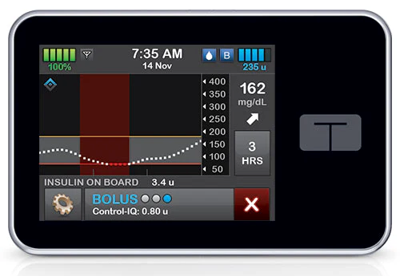
Data Collection:
The data collection for this was surprisingly easy. Normally, a diabetic needs to keep track of their own insulin, but with an insulin pump, this keeps track of your basal and bolus, along with a total amount daily.
Basal is the “Background” insulin, the amount given to adjust blood sugars automatically.
Bolus is the “Active” insulin. Whenever I eat, I require a ‘Bolus’ dosage.
Neither were included in the graphs or table
since they aren’t the targets of this study.

Slide 6
The Data itself:
Date: | Total Daily Units:
11/01/2024 | 110.89
11/02/2024 | 130.9
11/03/2024 | 124.96
11/04/2024 | 111.25
11/05/2024 | 97.67
11/06/2024 | 120.07
11/07/2024 | 124.01
11/08/2024 | 130.4
11/09/2024 | 121.1
11/10/2024 | 160
11/11/2024 | 142
11/12/2024 | 87.4
11/13/2024 | 78.9
11/14/2024 | 110.21
11/15/2024 | 90.82

Slide 7
Hypothesis and Alternative:
The Null: H0: μ = 108. My average insulin usage over two weeks is equal to 108 units.
The Alternative: H1: μ ≠ 108. My average insulin usage over two weeks is not equal to 108 units.
Since it’s “not equal to”, we will be using a two tailed t.test

Slide 8
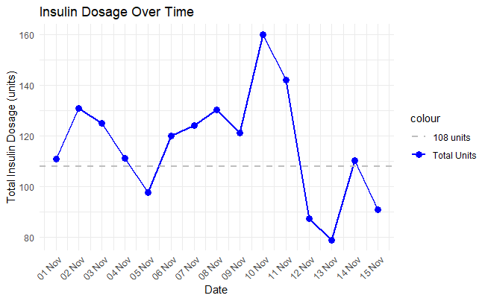
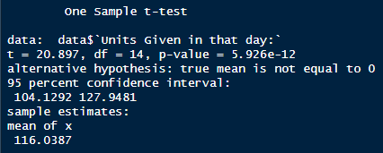
Test Results:
T value: 20.897
P value: Very small. (Less than 5%)
The mean of our actual daily usage is 116, which is higher than the 108 we were going for.

Slide 9
Conclusion
The P Value is less than 5%, so we reject the null hypothesis.
The average insulin dosage in a two-week period is significantly different from 108 units.

Slide 10
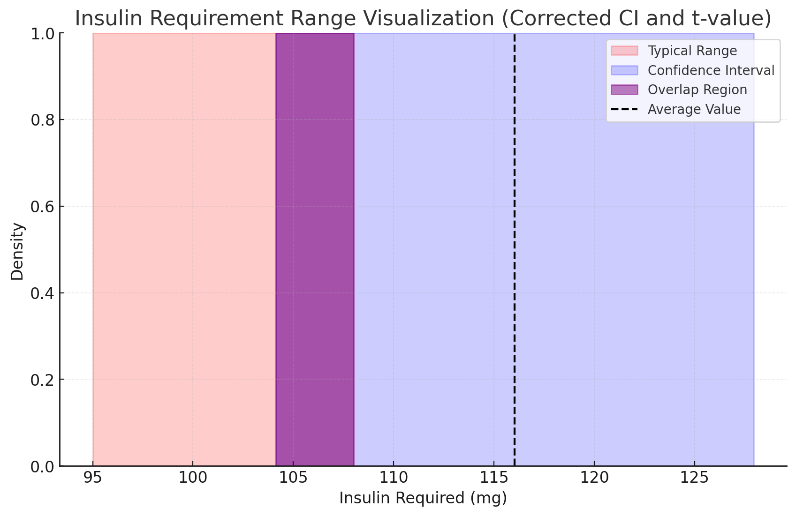
The Alternative Take:
While the null hypothesis is rejected, showing that my values significantly deviate from 108, it is within the range of confidence, as shown with the picture from R-Studio (Re-pasted here)
This shows that, while the mean of my intake was high, my insulin values don't significantly deviate from what might be considered a normal range.
A slightly different phrasing of the question could prove that my average daily dose is within the expected values.

Slide 11
Future Considerations:
Being sick for 2 out of the 14 days increased the mean substantially. If there was more data, or if those two days were excluded, it would be much closer towards 108.
More data points in general would give a better idea. 2 weeks is certainly not enough, but a month might be.

Slide 12
Resources:
https://pmc.ncbi.nlm.nih.gov/articles/PMC6995794/
https://www.cdc.gov/diabetes/treatment/index.html

